Slide 1
Quasars Selection Behind the Galactic Plane within |b|<5 deg
学院：物理学院
专业：天文学
答辩人：刘行健
指导老师：吴学兵
Notes:
Good morning, dear professors and my fellows, thank you for attending my thesis defense. The title of my thesis is Quasars Selection behind the Galactic Plane within five degrees to the galactic equator.

Slide 2
PART 01
Research Background
PART 02
GPQ Selection Method
PART 03
Trainingset Construction
PART 04
ML Classification
PART 05
GPQ Candidates
PART 06
Summary & Prospect
Notes:
I would introduce my thesis structure in six parts and the catalogue is shown here.

Slide 3
01
PART ONE
Research Background
Notes:
So let’s start with the research background.

Slide 4
01
Scientific Value
Reduce astrometry errors of Sky Surveys in low-b
Quasars are good astrometry references due to small parallaxes and proper motions.
Could help Gaia build better reference frames in the Galactic plane region.
Probe gas structures of the Milky Way
Line-of-sight absorption towards quasars help study the gaseous structures of Galactic plane.
Notes:
So why are we making efforts to finding quasars behind the galactic plane, which is also called GPQs? That’s because it’s of great scientific value for the study of Galactic plane. Firstly, they are useful probes of the Milky Way gas structure, and more importantly, they can help sky missions such as Gaia to build better reference frames for the Galactic plane region and reduce the astrometry errors of low-b sky surveys.

Slide 5
01
Current Studies
Million Quasars Catalog Version 7.10
Type/Region | Count
QSO/AGN | 845286
|b| < 20 deg | 39550
|b| < 5 deg | 1767
Notes:
However, according to the latest version of the Million Quasar Catalog, although we have found up to a million QSOs and AGNs, the findings are mainly in high-b regions, and only no more than two thousand of GPQs are found by far.

Slide 6
01
Difficulties
Higher source density causing worse photometry quality
Higher extinction and reddening
1
2
?
?
?
Many contaminants sharing similar observational properties
Dataset Shift from applying High-b selection methods
3
4
Notes:
And that’s because the difficulties we are facing in searching for GPQs are much more serious than that of high-b quasars. The higher extinction and reddening, the higher source density which results in worse photometry quality, and many more contaminants that share similar observational properties with GPQs such as Dwarfs and YSOs. And that means we cannot simply apply the selection methods developed for searching high-b quasars to low-b regions, due to the dataset shift.

Slide 7
02
PART TWO
GPQ Selection Method
Notes:
So we design a unique GPQ selection method,

Slide 8
02
Feature-based Transfer Learning
Fu et al. (2021)：modifying high-b selection methods by simulating dataset shift
Covariate shift：
Color difference
Dataset Level
Mapping extinction change
Prior shift：
Class imbalance
Algorithm Level
2-step binary classification
Notes:
Based on that of Fu et al. published in twenty twenty-one, which borrows the idea of feature-based transfer learning and simulates the dataset shift. At dataset level, we address the covariate shift caused by color difference by mapping the extinction change according to Galactic extinction law and Planck dustmap. At algorithm level, we design a two-step binary classification model to resolve the class imbalance issue.

Slide 9
02
Steps of Selection Methods
Crossmatch with PS1, UKIDSS, CatWISE2020
i,z,y,J,H,K,W1,W2 bands
and select good photometry
Construct features(colors) and train two
XGBoost classifiers
01
02
03
04
Construct trainingset of GPQs and Galaxies by sample mocking
Predict GPQs of |b| < 5 deg
and purify the candidates
Notes:
So the selection method is composed of four steps shown below, firstly crossmatch and obtain photometry data and set quality criteria, and second, construct the trainingset, third, construct features and train two XGBoost classifiers, and finally, apply the classifiers to the target region and after purification, generate the GPQ candidate catalog.

Slide 10
02
Method Improvements
A
B
C
Narrowing the target
sky region to |b| < 5 deg
Improvement of the mocking method
Adding UKIDSS JHK colors to classification features
D
E
Applying color cut to GPQ candidates
Modifying GPQ Prior probability distribution
and setting Posterior threshold
Notes:
However, since we are narrowing our target regions from 20 degrees to 5 degrees,compared with that of Fu et al., this selection method needs to be modified, and we make improvements in mainly these four aspects, and we will introduce them one by one in following slides.

Slide 11
03
PART THREE
Trainingset Construction
Notes:
So let’s come to the first improvement for the construction of the Training set.

Slide 12
03
Photometry Quality Selection
Criteria for Training set
Criteria for Testing set
Criteria | Meaning
snrW1pm > 5 & snrW2pm > 3 | Limiting W1 band SNRs
W1mproPM > 8 & W2mproPM > 7 | Limiting W1 band magnitudes
imag>14 & ymag>0 & zmag>0 | Limiting i,z,y magnitudes
j_1AperMag3Err < 0.2171 | Limiting J band SNRs
e_imag < 0.2171 | Limiting i band SNRs
Criteria | Meaning
snrW1pm > 5 & snrW2pm > 3 | Limiting W1 SNRs
W1mproPM > 8 & W2mproPM > 7 | Limiting W1 magnitudes
imag>14 & ymag>0 & zmag>0 | Limiting i,z,y magnitudes
j_1AperMag3Err < 0.2171 & hAperMag3Err < 0.2171 & kAperMag3Err < 0.2171 | Limiting J band SNRs
e_imag < 0.2171 & e_zmag < 0.2171 & e_ymag < 0.2171 | Limiting i,z,y magnitudes
gps_mergedclass != 0 & gps_mergedclass != 9 | Limiting GPS detection classes Not 0 (Noise) or 9 (Saturation)
cat_nb == 1 | Limiting number of blends for a point source in CatWISE2020

Slide 13
03
GPQ and Galaxy Samples
 | Dataset | Reference
High-b QSO Samples | SDSS_DR16Q_propclean | Wu & Shen (2022)
 | GaiaDR3_QSOC | Fu et al. to be submitted
High-b Galaxy Samples | SDSS_DR17_Gal | Abdurro’uf et al. 2022
Photometry Quality Selection
Limiting Magnitude Selection
PS1 Footprint Selection
GoodQSO
GoodGal
Notes:
In Fu et al. we mock the high-b GPQs and Galaxies to the galactic plane in only a single round, and we expect to expand the mock samples by applying multiple rounds of mocking.

Slide 14
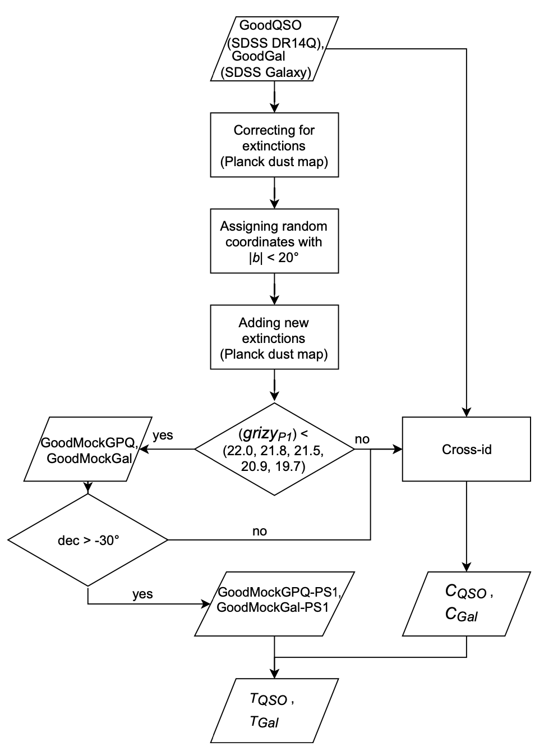
03
Sampling without Replacement
10 rounds:
Total Selection Rate
<50% → ~90%
Notes:
We made two attempts. Firstly we tried sampling without replacement, which means we do not put back the selected high-b sources into the input of following rounds of mocking. And after ten rounds, the total selection rate is boosted to around ninety percent.

Slide 15
03
Sampling with Replacement
10 rounds:
Total Selection Rate
<50% → >95%
Notes:
Then we tried sampling with replacement, where in each round we input the total of high-b sources and drop the sources that have been selected in previous rounds in the mock samples. After ten rounds, we boosted the total selection rate to higher than ninety five percent.

Slide 16
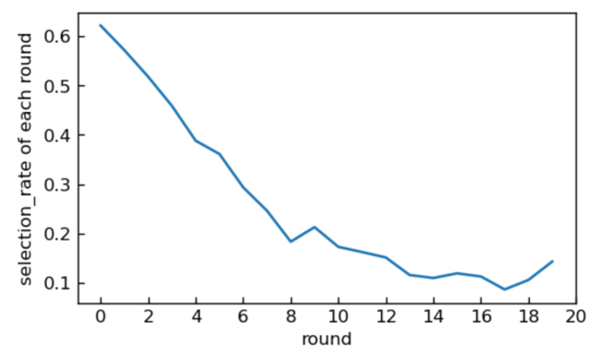
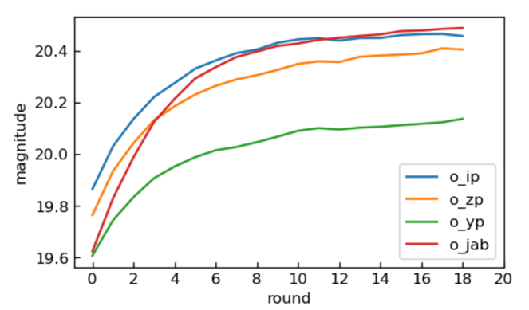
03
Comparison
 | Theory | Practice
Sampling without Replacement | Different from that of Statistics: Not random | Quality of Dataset decreasing Selection rate decreasing GoodQSO total selection rate: 10 rounds → 91.92%
Sampling with Replacement | Same as Bootstrapping | Selection rate only depending on random seeds GoodQSO total selection rate: 10 ronds → 95.07%
Sampling without Replacement
Notes:
Comparing the two methods, we find that the second one stands out. Theoretically, the first one is not statistically random, because the sources that are drawn out of the input of each round is not randomly selected. But the second one is the same as bootstrapping in statistics, and has better randomness. And practically, the selection efficiency of Bootstrapping is much higher, since the quality of the input dataset of the second method is decreasing in each round.

Slide 17
03
Mocking Result
 | Input | GoodMock Samples | Total Selection Rate
GoodQSO | 175175 | GoodMockGPQ: 166535 | 10 rounds：95.07%
GoodGal | 156805 | GoodMockGal: 156794 | 10 rounds：99.99%
GoodGal brighter than GoodQSO:
Higher total selection rate
Notes:
So the final choice is Bootstrap Mocking, and the results are shown here. We also plot the sky density of mock samples, and we can see the density of GPQ and Galaxy samples at the galactic center is much lower than that of the anticenter, due to the higher extinction and reddening. Also we can see the mocking efficiency for Galaxies is much higher than GPQs, and that’s because the input galaxies are much brighter.

Slide 18
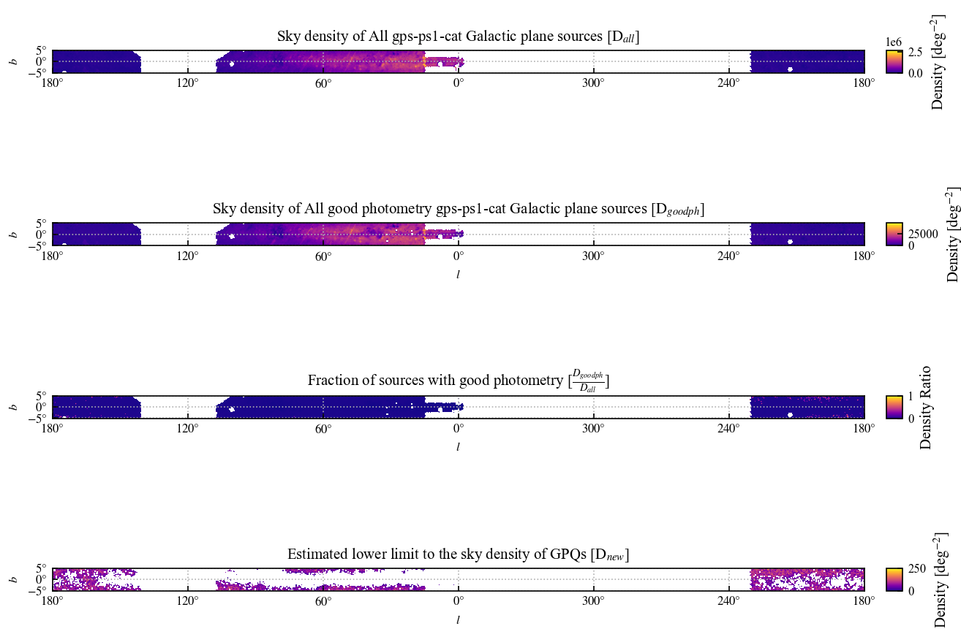
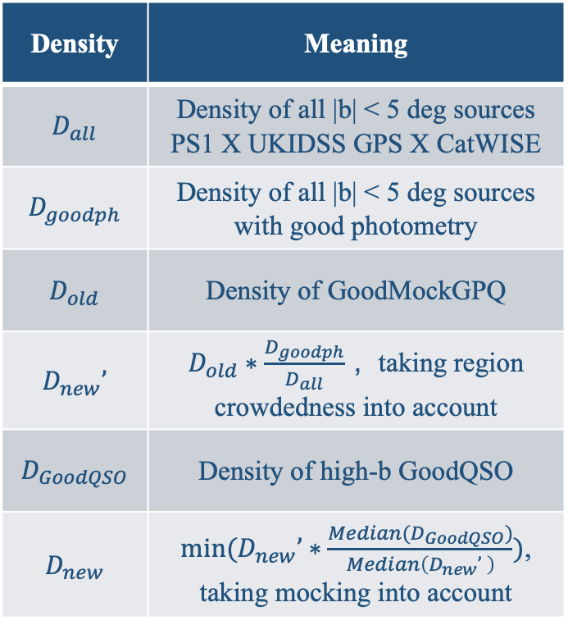
03
Calculating Prior Distribution
Region Crowdedness (Source Density)
Calculating GPQ Prior Probability Distribution
Modifying GoodMockGPQ
Sky Density Distribution
Rounds and Methods of Mocking
Density | Meaning
$D_{all}$ | Density of all |b| < 5 deg sources PS1 X UKIDSS GPS X CatWISE
$D_{goodph}$ | Density of all |b| < 5 deg sources with good photometry
$D_{old}$ | Density of GoodMockGPQ
$D_{new}’$ | $D_{old}∗\frac{D_{goodph}}{D_{all}}$ ，taking region crowdedness into account
$D_{GoodQSO}$ | Density of high-b GoodQSO
$D_{new}$ | $min(D_{new}’∗\frac{Median(D_{GoodQSO})}{Median\left(D_{new}’ \right)})$, taking mocking into account
Notes:
After constructing GPQ samples, we calculate the prior probability distribution of GPQs for following uses. Since there is deviation between the distribution of mock GPQ samples and that of real sky GPQs, we modify the distribution of mock GPQs by taking two things into consideration: the real sky crowdedness, or to say, source density, and the specific process of mocking. The calculation is shown in this table, and we plot the useful sky density distributions here.

Slide 19

03
Smoothing Prior Distribution
Splitting All-Sky into More Pixels：Nside=64 → Nside=256
$${ P}_{prior}=\frac{D_{new}}{D_{goodph}}$$
Setting boundary outliers of Healpixmap as median sky density
Notes:
In order to smooth the prior probability distribution, we increase the nside of healpixmap, splitting all-sky into more pixels, and we also manually set boundary outliers as the median of sky density. A smoothed prior distribution ensures that it would not dominate the posterior distribution and make the effect of classification model invisible.

Slide 20
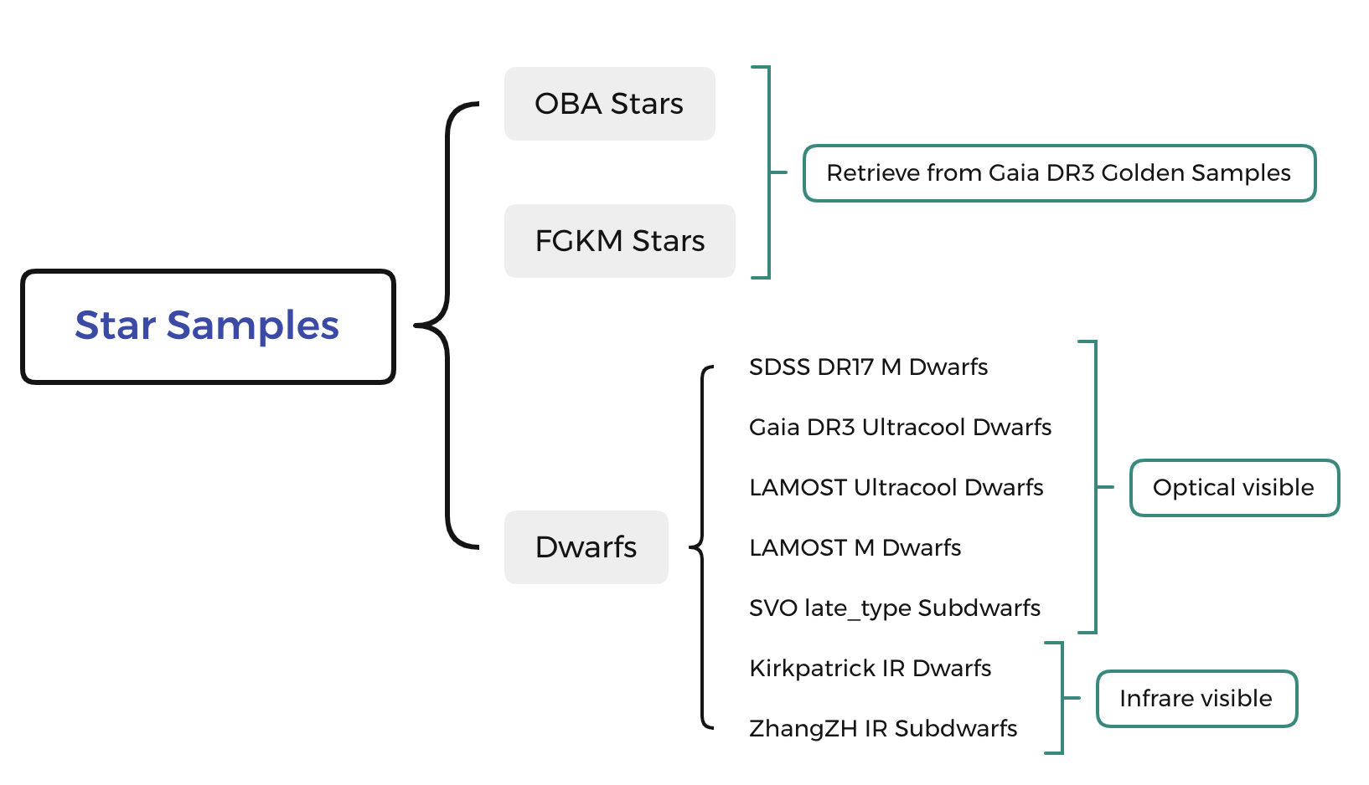
03
Star Samples
Photometry Quality Selection
Limiting Magnitude Selection
PS1 Footprint Selection
Notes:
As for star samples, we retrieve the OBA stars and FGKM stars from Gaia DR3 Golden Samples to ensure a high purity. We also supplement some dwarfs samples to improve the representativeness for the real sky stellar distribution.

Slide 21
03
Color Diagrams of Trainingset
Type | Count
Star | 476373
QSO | 120891
Galaxy | 111681
Notes:
Here we show the color diagrams of trainingset, which is also the distribution of features for following classification. Here the red points stand for stars.

Slide 22
04
PART FOUR
ML Classification
Notes:
The next part is the construction of classification model.

Slide 23
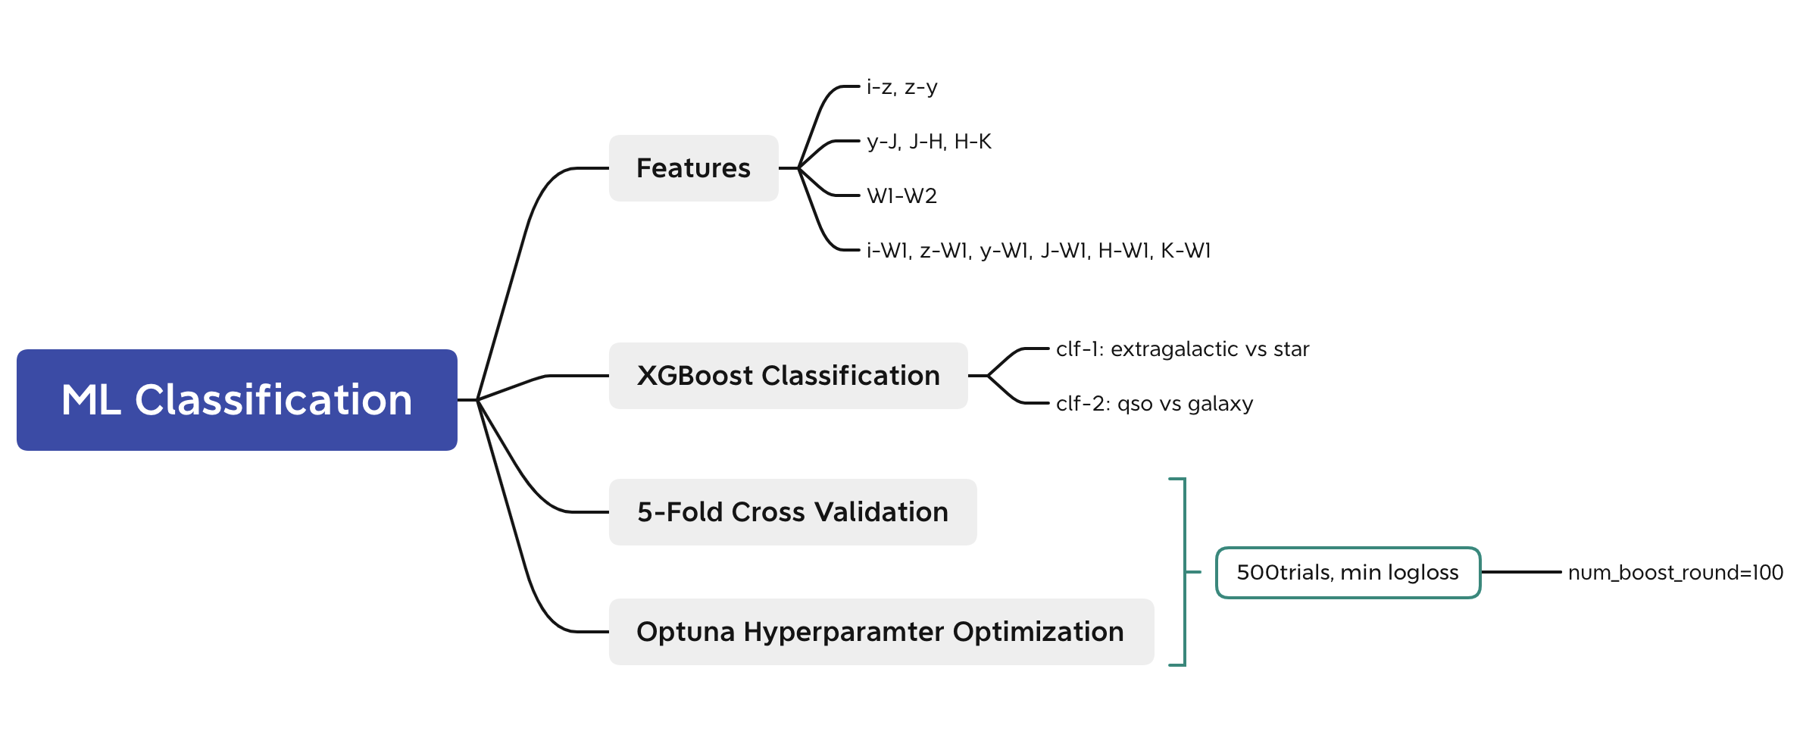
04
XGBoost Classification Model
Notes:
We construct features based on colors, and compared to Fu et al., we remove the g band and r band of PS1 because of high extinction, and add UKIDSS J, H, and K bands to improve the search for high redshifted quasars. We use XGBoost for classification and train an independent classifier for each step. We apply a five-fold cross validation and we use Optuna to tune the hyperparameters.

Slide 24
04
Optuna Optimal Hyperparams
 | clf-1 | clf-2
eta | 0.3 | 0.1
lambda | 2.9077613895719 | 0.8545938248212175
alpha | 1.5263290780459133 | 0.4512391408998466
max_depth | 9 | 8
gamma | 1.0003397864024768 | 0.2038341012648358
grow_policy | depthwise | depthwise
min_child_weight | 4 | 1
subsample | 0.9129317176922225 | 0.9094012577087329
colsample_bytree | 0.9886871929591262 | 0.8079200202937279
max_delta_step | 6 | 2
num_boost_round fixed to 100
Loss Function: logloss
5-fold cross validation
500 sampling trials
After passing hyperparams
adjust eta and n_estimators
to reduce generalization error
Notes:
The result of optuna optimized hyperparams are shown here and after passing them to the classifiers, we adjust the learning rate and number of boosting rounds to reduce generalization error.

Slide 25
04
Model Assessment
eta=0.05, n_estimators=1000
eta=0.02, n_estimators=1000
Metrics | clf-1 Default | clf-1 Optimized
Accuracy | 0.999147 | 0.999189
Precision | 0.999496 | 0.999538
Recall | 0.999233 | 0.999255
F1 | 0.999365 | 0.999396
MCC | 0.998065 | 0.998161
AUCPR | 0.999990 | 0.999991
Metrics | clf-2 Default | clf-2 Optimized
Accuracy | 0.987337 | 0.987703
Precision | 0.987795 | 0.987844
Recall | 0.987836 | 0.988498
F1 | 0.987816 | 0.988171
MCC | 0.974636 | 0.975367
AUCPR | 0.998354 | 0.998521
Notes:
We use several metrics for model assessment. The first four are commonly used for machine learning models, but they could be severely biased in the case of class imbalance, so we add Matthews correlation coefficients and the area under PR curves as supplements. From the metrics tables we can see the importance of Optuna optimization.

Slide 26
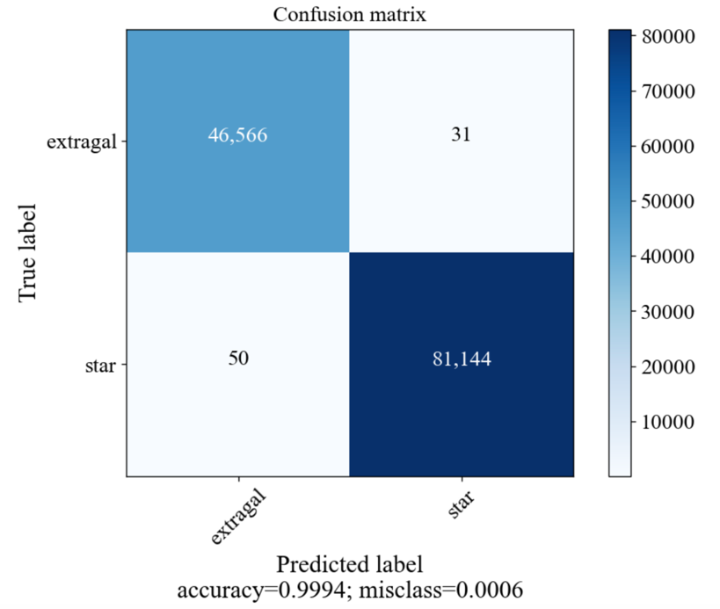
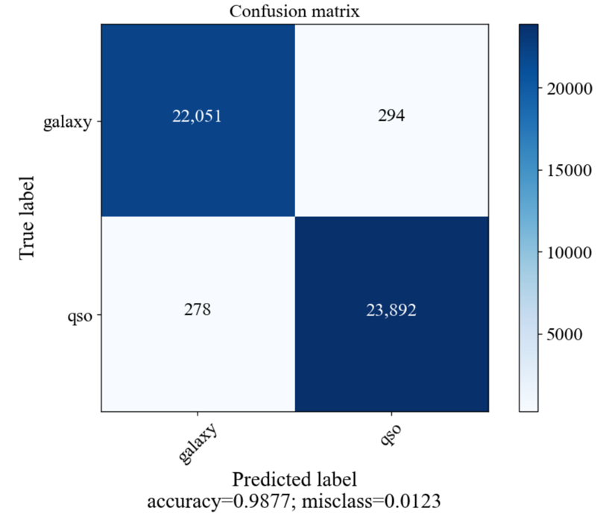
04
Model Evaluation
Notes:
And we also plot the confusion matrixes. We can see that in step two XGBoost performs not so well as that in step one, and that’s mainly because the overlap between galaxies and GPQs is bigger than that between stars and GPQs.

Slide 27
04
Feature Importance
Frequency
Clf-1
Gain
Notes:
The feature importance is shown below, and we can see the importance of JHK colors for classification is obvious.

Slide 28
04
Feature Importance
Frequency
Clf-2
Gain
Notes:
The feature importance is shown below, and we can see the importance of JHK colors for classification is obvious.

Slide 29
05
PART FIVE
GPQ Candidates
Notes:
Then we apply our classification model to the target region and generate GPQ candidates.

Slide 30
05
Candidate Prediction: PredGPQ
Testing set: All sources of |b| < 5 deg
(PS1 X UKIDSS GPS X CatWISE2020)
clf-1
clf-2
PredGPQ
>99%
>99%
Notes:
We select the sources which is ninety-nine percent or higher likely to be extragalactic objects and is also ninety-nine percent or higher likely to be a Quasar in the two classification steps. But that results in a million of PredGPQ candidates, which is because the high contamination of stellar objects, as we can see from the sky density plot and color-color distribution.

Slide 31





05
Candidate Prediction: PredGPQ
Testing set: All sources of |b| < 5 deg
(PS1 X UKIDSS GPS X CatWISE2020)
clf-1
clf-2
PredGPQ
>99%
>99%
Notes:
We can see that the deviation between PredGPQ and MockGPQ samples is large, and the overlap between PredGPQ and stellar locus is big.

Slide 32
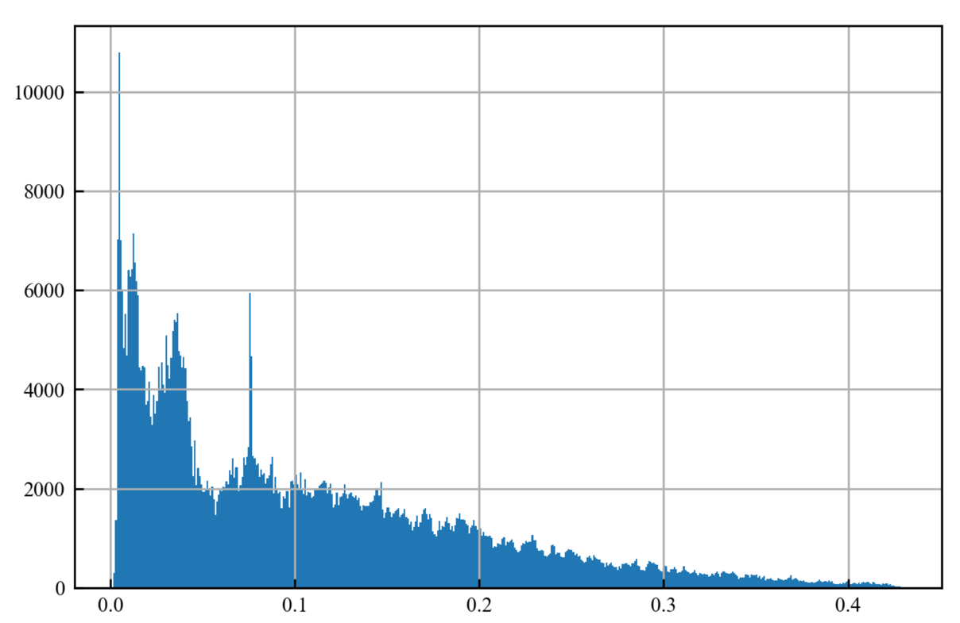
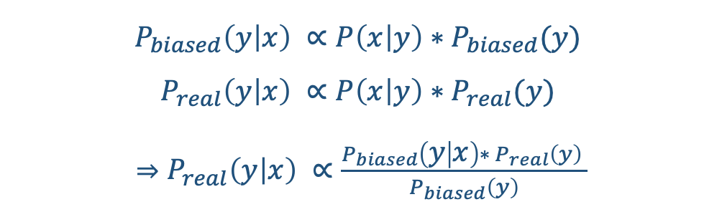
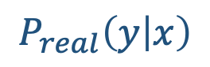
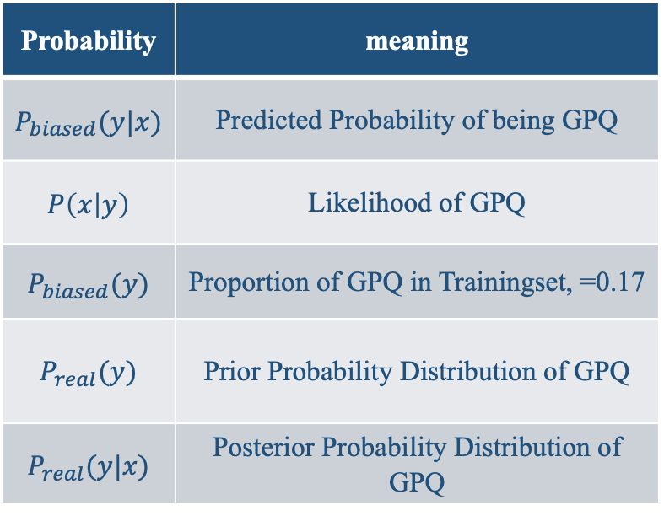
05
GPQ Posterior Distribution
$$P_{biased}\left(y | x\right) ∝P\left(x | y\right)∗P_{biased}(y)$$
$$P_{real}\left(y | x\right) ∝P\left(x | y\right)∗P_{real}(y)$$
$⇒$ $P_{real}\left(y | x\right) ∝\frac{P_{biased}\left(y | x\right)∗ P_{real}\left(y\right) }{P_{biased}\left(y\right)}$
$$P_{real}\left(y | x\right)$$
Probability | meaning
$P_{biased}(y|x)$ | Predicted Probability of being GPQ
$P\left(x | y\right)$ | Likelihood of GPQ
$P_{biased}(y)$ | Proportion of GPQ in Trainingset, =0.17
$P_{real}(y)$ | Prior Probability Distribution of GPQ
$P_{real}(y|x)$ | Posterior Probability Distribution of GPQ
28591
PredGPQ_30
Notes:
So we are seeking to remove the stellar contaminants by purification. Firstly, we calculate the GPQ posterior distribution according to the bayesian formula, and set a threshold of thirty percent, so as to guarantee the purity and completeness of the GPQ candidates at the same time. We obtain a pred GPQ thirty of around thirty thousand candidates.

Slide 33


05
Purification: Posterior Threshold
PredGPQ_30
PredGPQ
Notes:
We can see the improvement of purity from the color diagrams that the deviation is mitigated and stellar contaminants reduced.

Slide 34
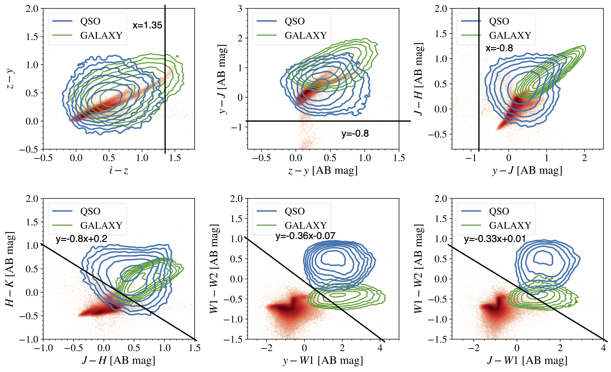
05
Purification: Color Cut
Choose cutting curves
in color diagrams
to remove stellar contaminants
Cutting Curves:
i-z < 1.5
& y-J > -0.8
& H-K+0.8*(J-H) > 0.2
& W1-W2+0.36*(y-W1) > -0.07
& W1-W2+0.33*(J-W1) > 0.01
Notes:
Besides, we also apply a further color cut by separating stars and GPQs on the color diagrams with cutting curves.

Slide 35


05
Purification: Color Cut
PredGPQ_30_colorcut
PredGPQ_30
4222 GPQ Candidates
Notes:
And results give around four thousand of purified GPQ candidates, and they are clearly separated from the stellar locus on the color diagrams.

Slide 36
05
GPQ Candidates Sky Density
Posterior Threshold
Color Cut
Notes:
Finally, we plot the sky density distribution of GPQ candidates. We can see they are mainly distributed on the galactic anticenter, and that is mainly because of the much higher extinction of equator regions. Nevertheless, there are still a few candidates located near the galactic equator, which proves the feasibility of our selection method.

Slide 37
06
PART SIX
Summary & Prospect
Notes:
So, to sum up

Slide 38
06
Research Summary
Mocking Methods
Classification Features
01
02
Recycling Mocking: with/without replacement
Total Selection Rate：<50% → >95%
Remove: PS1 g,r bands (high extinction)
Add：UKIDSS J,H,K bands
Prior & Posterior Calculations
Candidate Purifications
03
04
Healpixmap → Prior & Bayes → Posterior
Smoothing of Prior Distribution
Posterior Threshold: >0.3
Color Cut: Cutting Curves
Notes:
We make four main improvements, as is shown on the slide, and we generate a GPQ candidate catalog within 5 degrees to the galactic equator.

Slide 39
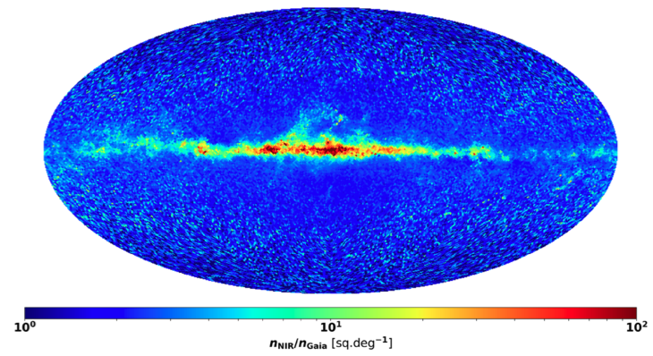
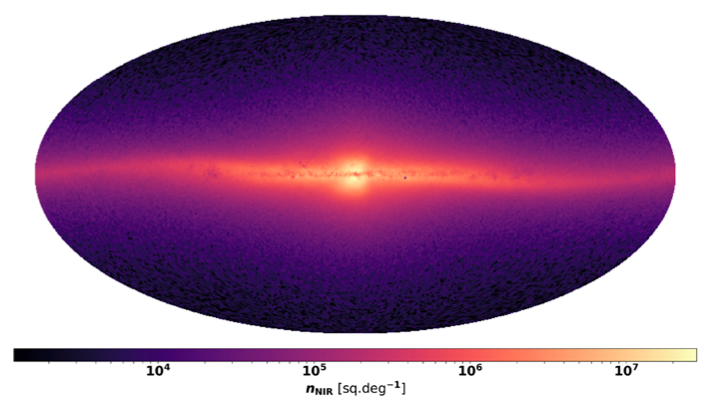
06
Prospective Application
GaiaNIR: A Future All-Sky Astrometry Mission
Gaia: Optical, Galactic plane obscured
GaiaNIR: +NIR, penetrate into Galactic center
Notes:
Our candidates and selection method could provide a prospective supplement for Gaia Near Infrared, which is a future all sky astrometry mission that aims to extend the detection area to the deep galactic center. As GPQs are important astrometry references, the study of galactic plane region is expected to be facilitated.

Slide 40
06
Follow-ups
Apply Gaia (or CatWISE) proper motion cut
and calculate probability function of pm=0
D
3
Supplement dwarfs to improve the representativeness of star sample
C
1
B
Carry out spectroscopic identification for GPQ candidates using optical telescopes
4
Add X-ray features to classification
to reduce stellar contamination
eg. X-ray hardness ratio, X-ray flux
A
2
Notes:
For follow-up studies, we expect to make improvements towards mainly three directions: improve the representativeness of trainingset samples, add X-rays band features for better classification performance, apply proper motion cuts to further remove stellar contaminants. We are also applying for optical telescopes for spectroscopic identification of the GPQ candidates.

Slide 41
Thanks for Listening
15906332319
liuxingjianpku@pku.edu.cn
Notes:
That’s all, thanks for listening. Any suggestions will be highly appreciated.

